Slide 1

ModelIt!
Student Lesson
Earth Has a Fever
Why 2 Degrees Could Change Everything
NGSS: MS-ESS3-5
7th Grade
1/9

Slide 2
What You Will Learn Today
Learning Goals
* Explain how the greenhouse effect traps heat in Earth's atmosphere
* Model how increasing CO2 concentration affects global temperature and ice coverage
* Predict cascade effects of rising temperatures on sea level and weather patterns
* Evaluate human contributions to climate change using model evidence
Key Vocabulary
Greenhouse Effect
The process where certain gases in Earth's atmosphere trap heat from the Sun, warming the planet's surface
Carbon Footprint
The total amount of greenhouse gases produced by human activities, measured in CO2 equivalents
Thermal Expansion
When water warms, its molecules move faster and spread apart, causing ocean water to take up more space
Feedback Loop
When the output of a system amplifies or reduces the original input, creating a cycle
2/9

Slide 3
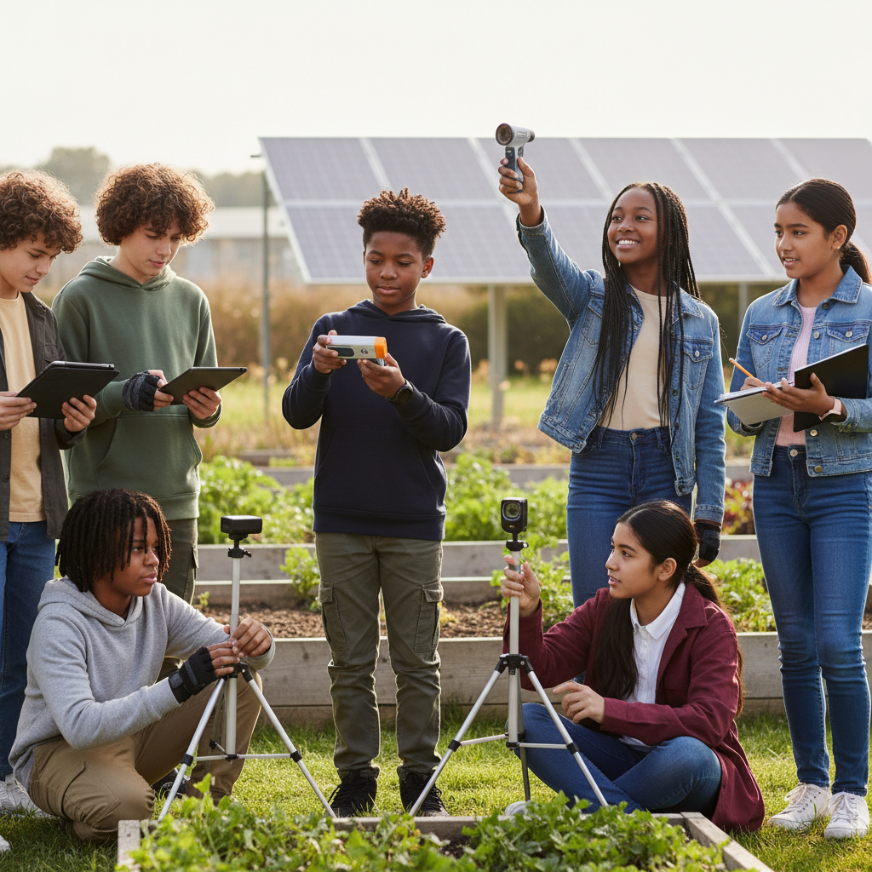
The Big Question
If Earth's temperature rises by just 2 degrees Celsius, why could it change everything?
Why 2 Degrees Could Change Everything. Today we'll build a MODEL to discover the answer!
3/9

Slide 4
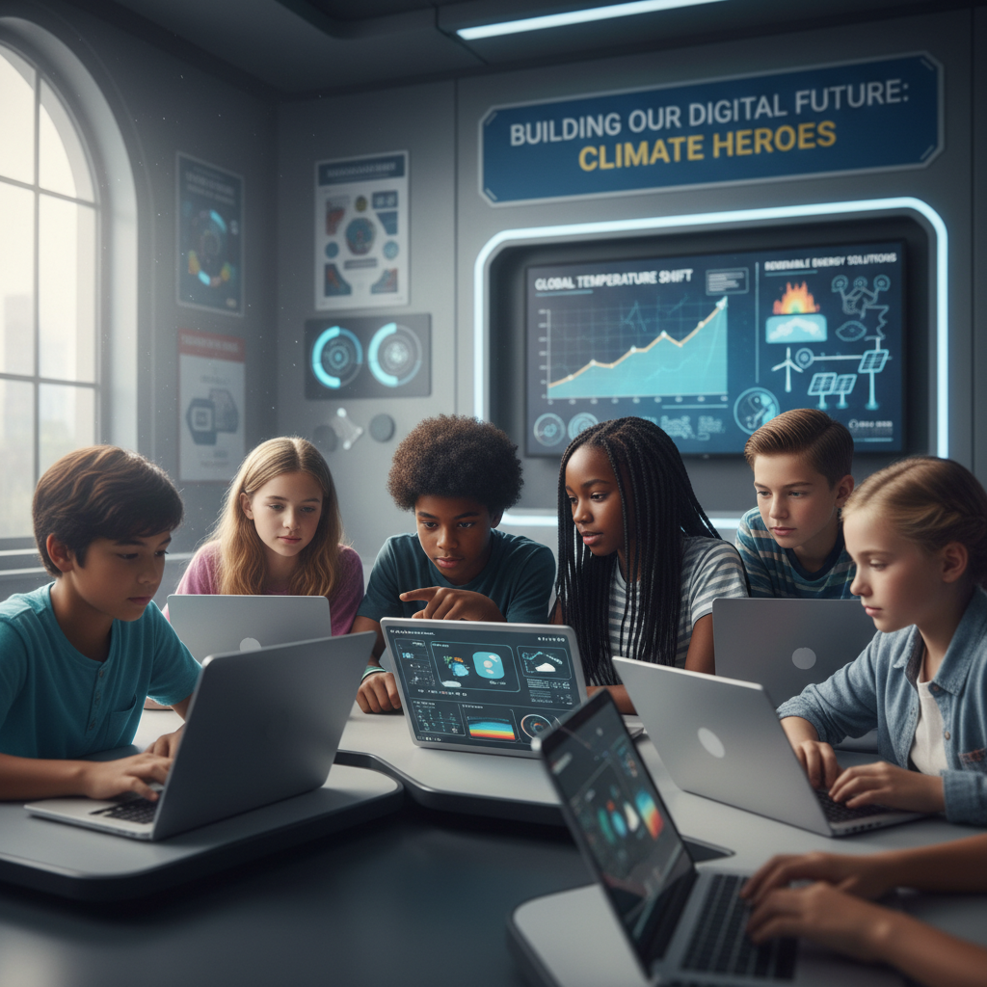
Today We Will Build a Model!
A model helps us understand complex systems!
1. LOCATE
Identify the COMPONENTS (parts) of the system
2. ESTABLISH
Connect them with RELATIONSHIPS (+ or -)
3. VISUALIZE
Build your model in ModelIt!
4. EVALUATE
Run SIMULATIONS to test scenarios
5. REVISE
Improve your model based on evidence
4/9

Slide 5

Activity 1: Sort the Components
Sort these components into EXTERNAL (inputs from outside) and INTERNAL (inside the system):
Your Components:
* CO2 Concentration
* Solar Energy Input
* Average Global Temperature
* Ice Sheet Coverage
Think: Which components can we control? Which happen on their own?
5/9

Slide 6
Activity 2: Connect with Arrows
Draw arrows to show HOW components affect each other:
(+) POSITIVE Relationship
When one goes UP, the other goes UP too
(-) NEGATIVE Relationship
When one goes UP, the other goes DOWN
Think About It:
When CO2 concentration increases, global temperature rises. But what happens to ice sheets when temperature rises — and does melting ice create a feedback loop?
6/9

Slide 7
Activity 3: Run the Simulation!
Test these scenarios in ModelIt!
Pre-Industrial Baseline
Set CO2 Concentration to low (280 ppm) and observe temperature stability
Current Trajectory
Lock CO2 Concentration to high levels and observe cascade effects on temperature and ice
Paris Agreement Goals
Set CO2 to moderate reduction levels and compare to current trajectory
Watch the activity graphs change!
[ModelIt Platform Screenshot - Simulation Results Graph]
7/9

Slide 8
What Did We Discover?
Our Model Showed Us:
* CO2 acts like a blanket — more CO2 traps more heat, raising global temperature
* Rising temperatures melt ice sheets, which reduces Earth's reflectivity and causes MORE warming (positive feedback)
* Even 2°C of warming dramatically changes weather patterns, sea levels, and ecosystems
* Human activities have increased atmospheric CO2 by over 50% since the Industrial Revolution
Answer: Even 2°C of warming matters enormously because Earth's climate system has feedback loops. Rising CO2 traps heat, which melts ice, which exposes dark ocean that absorbs MORE heat, causing MORE melting. Small temperature changes cascade into massive effects on sea level, weather, and ecosystems!
8/9

Slide 9
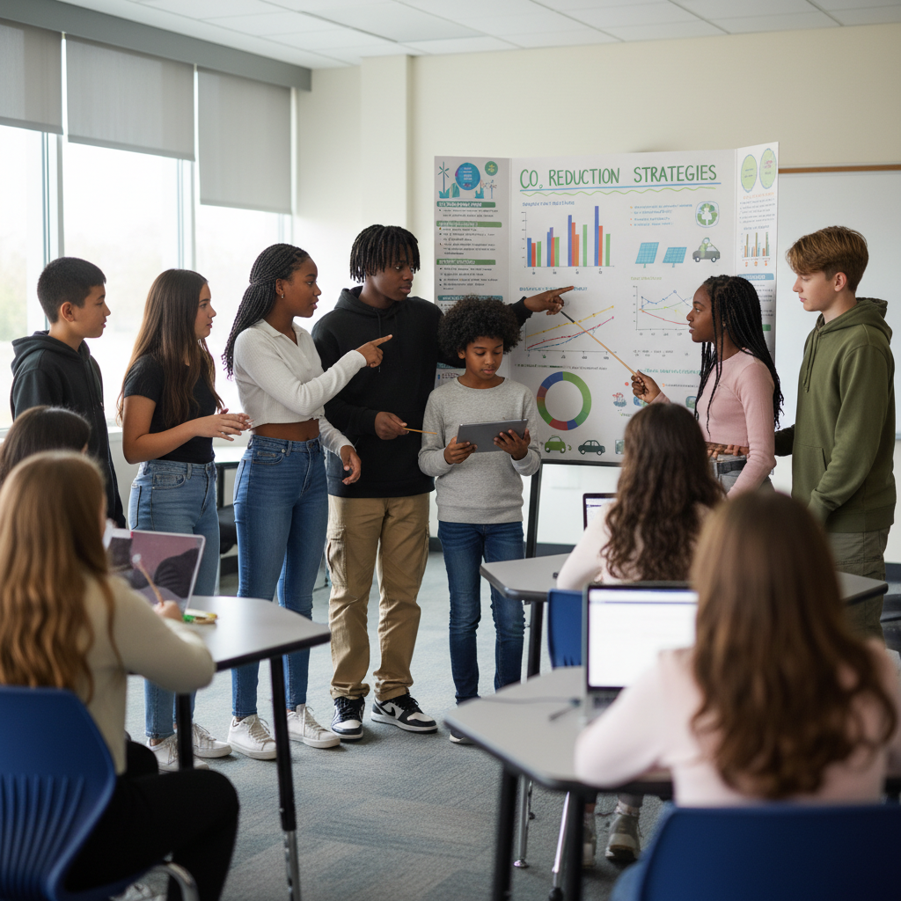
STEM Challenge: Design a School Climate Action Plan
YOUR ENGINEERING MISSION
Create an evidence-based climate action plan for your school that reduces carbon emissions and educates the community, using data from your model.
The Challenge:
Your school district wants to reduce its carbon footprint by 50% in 10 years. The superintendent needs your team to propose specific actions with evidence showing they'll work.
Think Like an Engineer:
* Which actions would reduce your school's carbon footprint the most?
* How can you use your model to show the impact of different reduction strategies?
* What role can students play in fighting climate change at the local level?
REAL CAREER CONNECTION: Climate Scientists analyze climate data and build complex models to predict future conditions. They work for NOAA, NASA, universities, and environmental organizations, earning $80,000–$140,000/year. The skills you're using TODAY are the same ones they use on the job!
9/9

